Slide 1
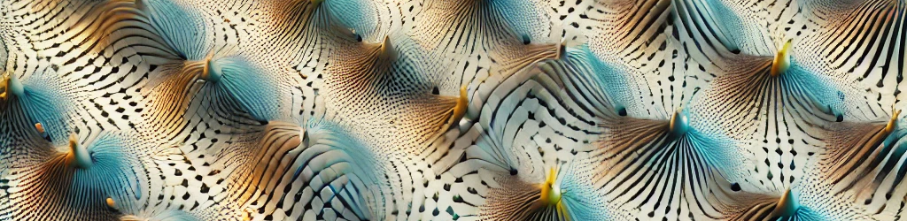
Chiral magnetic Josephson junctions (Sup Spin)
art
18/07/2024
Justin Chen

Slide 2
Motivation
Hall response: determines electrical transport response to magnetization by AHE
RAHE was treated as a proxy for skyrmions in chiral magnetic systems and was thought to arise from the Topological Hall Effect
What our experiments tells us: we have large RAHE in chiral/ achiral with or without skyrmions

Slide 3
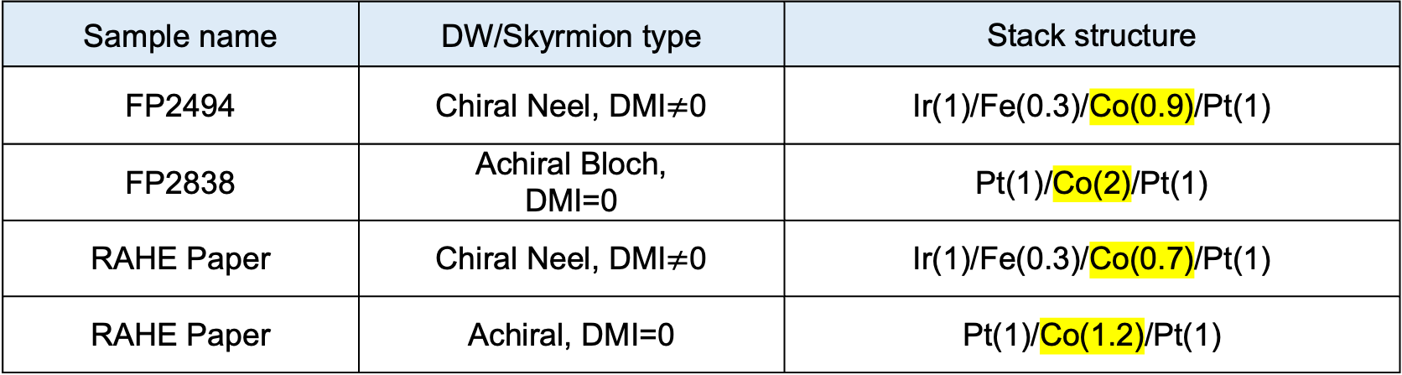
Objectives
Simulate theoretical interaction of Skyrmion-Vortex pairs (SVPs).
Use cryo-probe and other instrumentation to experimentally analyze stacks and compare against simulated results
Sample name | DW/Skyrmion type | Stack structure
FP2494 | Chiral Neel, DMI$≠$0 | Ir(1)/Fe(0.3)/Co(0.9)/Pt(1)
FP2838 | Achiral Bloch, DMI=0 | Pt(1)/Co(2)/Pt(1)
RAHE Paper | Chiral Neel, DMI$≠$0 | Ir(1)/Fe(0.3)/Co(0.7)/Pt(1)
RAHE Paper | Achiral, DMI=0 | Pt(1)/Co(1.2)/Pt(1)
Note: we will not compare the two achirals as MH curves not comparable, and we will only compare chiral and achiral samples with similar MH curves, made in the same sputtering session for maximum comparability

Slide 4
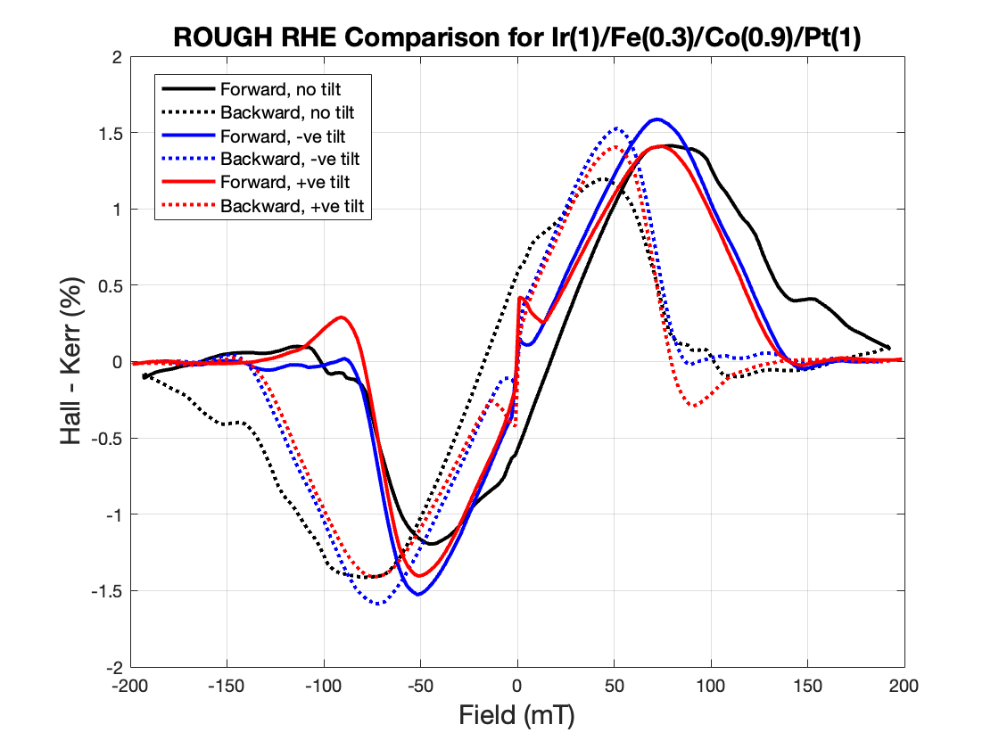
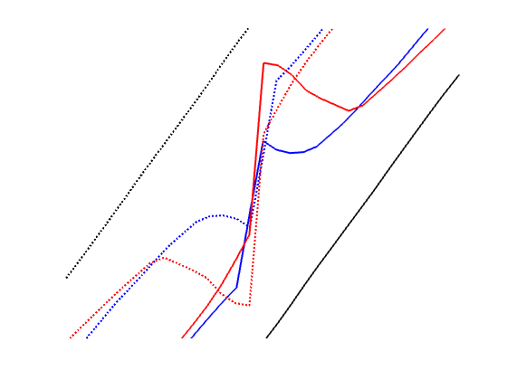
Results: Chiral Tilt Dependence, test
Did not record angles
But we see that tilt affects the gap

Slide 5
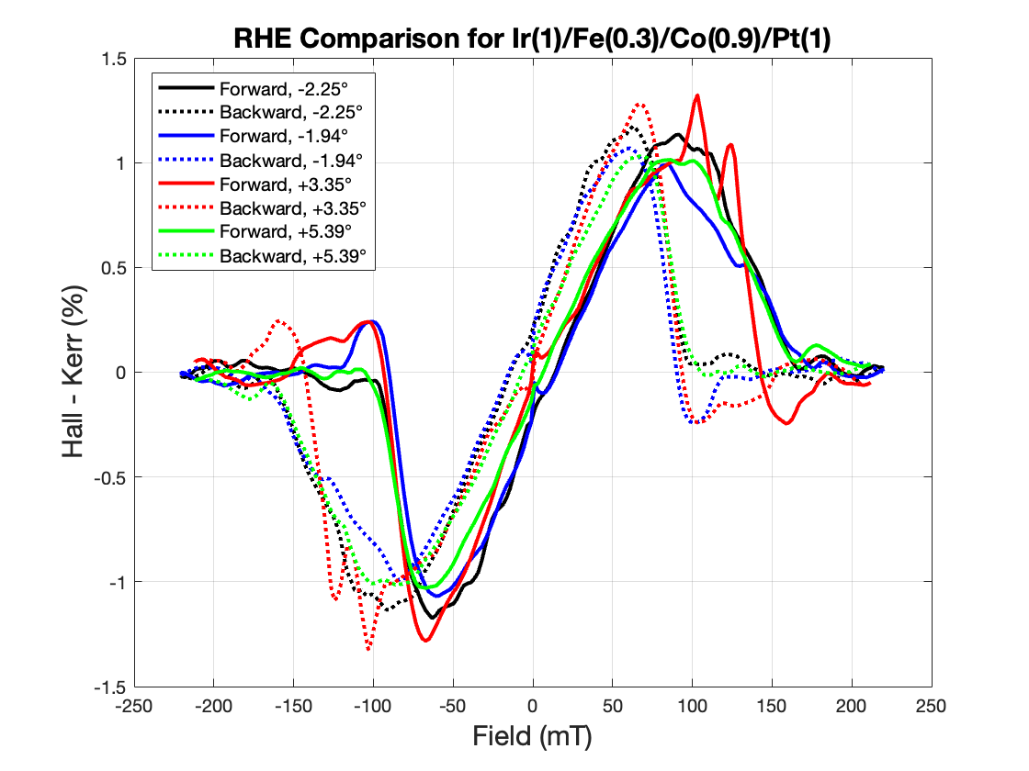
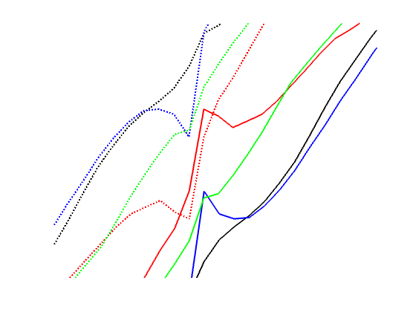
Results: Chiral Tilt Dependence
No visible angle dependence, even if we consider angle magnitude
Signal too noisy

Slide 6
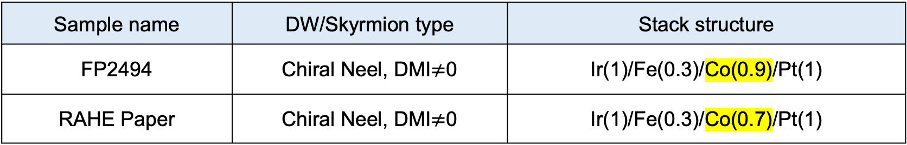
Expectation: Co(0.9) vs Co(0.7)
Sample name | DW/Skyrmion type | Stack structure
FP2494 | Chiral Neel, DMI$≠$0 | Ir(1)/Fe(0.3)/Co(0.9)/Pt(1)
RAHE Paper | Chiral Neel, DMI$≠$0 | Ir(1)/Fe(0.3)/Co(0.7)/Pt(1)
Magnetic anisotropy and coercivity: As Co layer thickens, perpendicular magnetic anisotropy (PMA) might reduce, and coercivity increases. Larger coercivity might lead to smaller remanence, reducing RHE at low fields.
SOC and DMI: Strong SOC and DMI in thinner layers can lead to more complex spin textures and a larger RHE. Thicker Co layers can diminish these effects, leading to a smaller RHE
Magnetization and domain structure: Thinner layers generally exhibit more uniform magnetization and DW effects, leading to a larger RHE. Thicker layers can exhibit more complex DW structures and DW pinning, which can scatter electrons and reduce the RHE

Slide 7
Expectation: Co(0.9) vs Co(0.7)
Sample name | DW/Skyrmion type | Stack structure
FP2494 | Chiral Neel, DMI$≠$0 | Ir(1)/Fe(0.3)/Co(0.9)/Pt(1)
RAHE Paper | Chiral Neel, DMI$≠$0 | Ir(1)/Fe(0.3)/Co(0.7)/Pt(1)
Magnetic anisotropy and coercivity: As Co layer thickens, perpendicular magnetic anisotropy (PMA) might reduce, and coercivity increases. Larger coercivity might lead to smaller remanence, reducing RHE at low fields.
SOC and DMI: Strong SOC and DMI in thinner layers can lead to more complex spin textures and a larger RHE. Thicker Co layers can diminish these effects, leading to a smaller RHE
Magnetization and domain structure: Thinner layers generally exhibit more uniform magnetization and DW effects, leading to a larger RHE. Thicker layers can exhibit more complex DW structures and DW pinning, which can scatter electrons and reduce the RHE
Therefore, we expect Fe(0.3)/Co(0.9) to have a smaller RHE

Slide 8
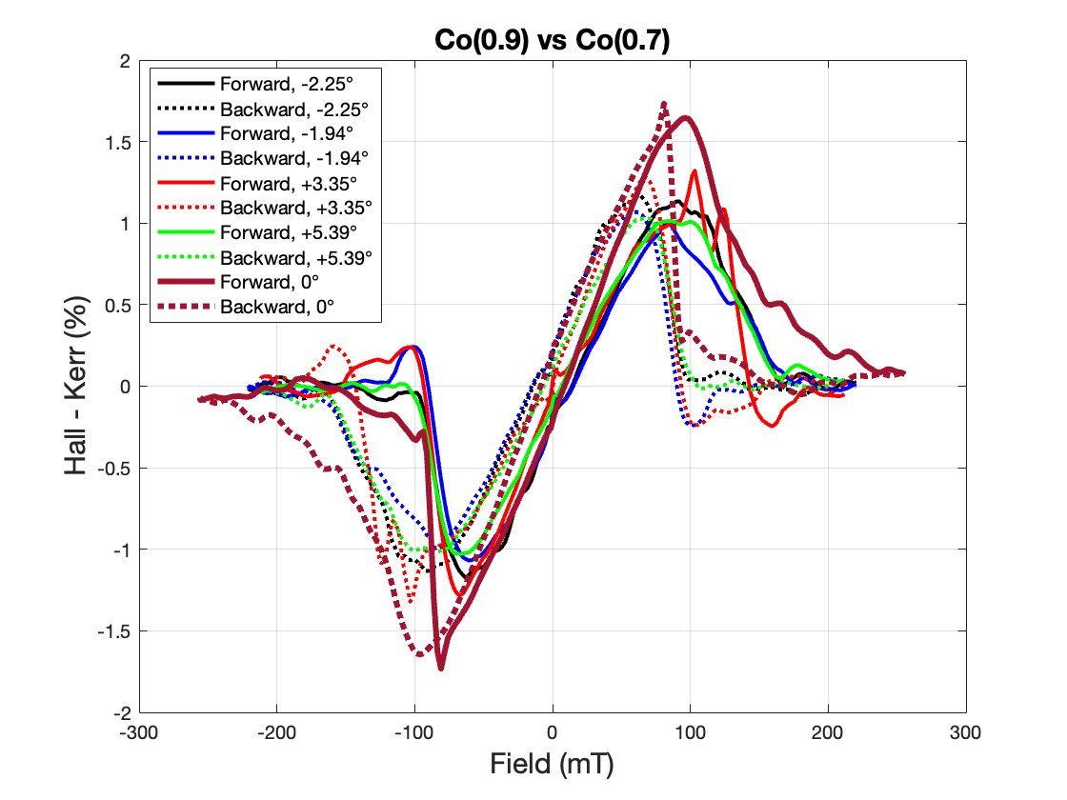
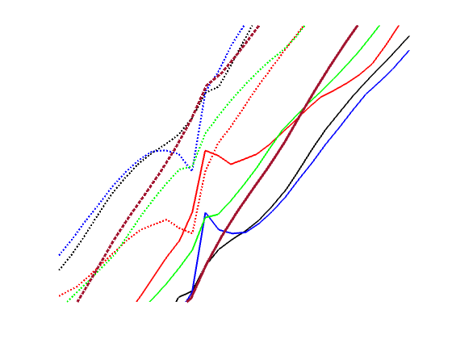
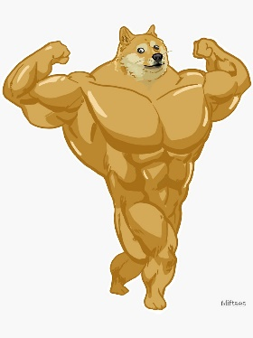
Results: Co(0.9) vs Co(0.7)
We do indeed see that Co(0.9) has a smaller RHE %
Burgundy curve is between –ve and +ve curve, suggesting Gunasheel indeed adjusted to 0 deg tilt by eye

Slide 9
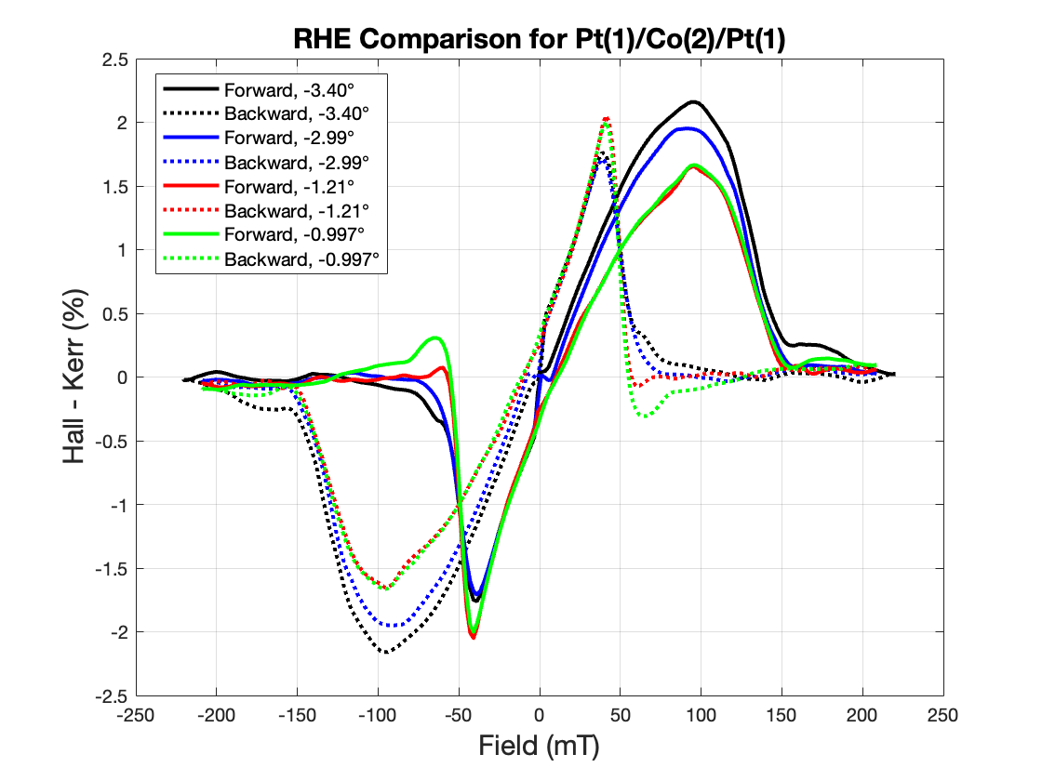
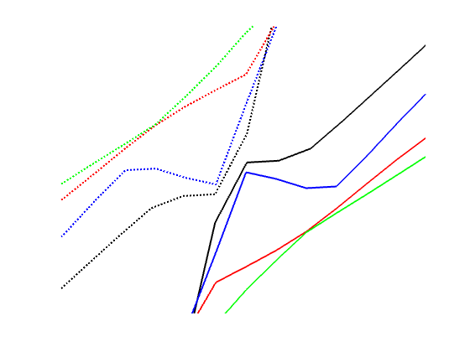
Results: Achiral Tilt Dependence

Slide 10
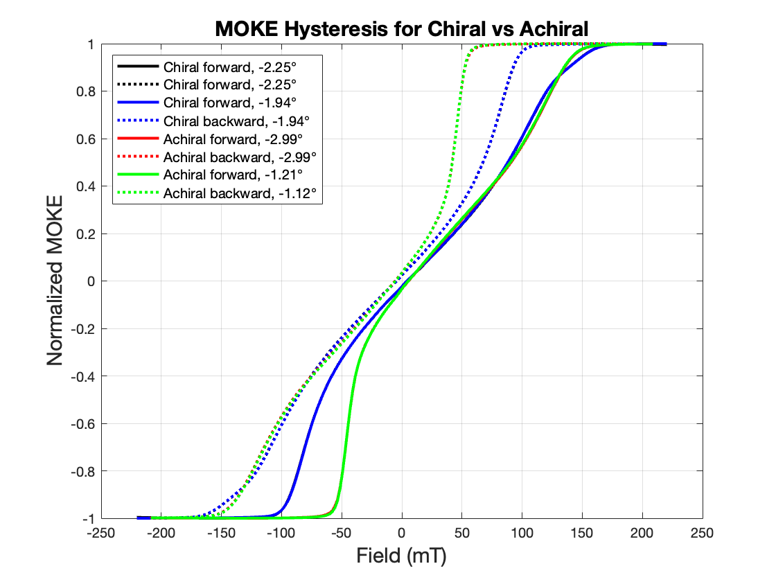
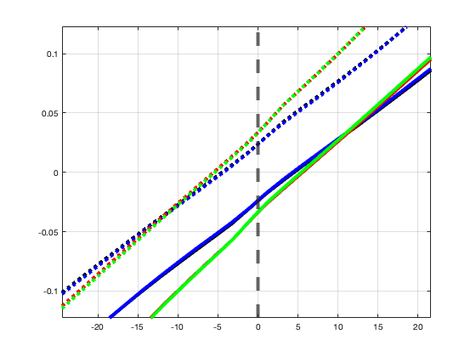
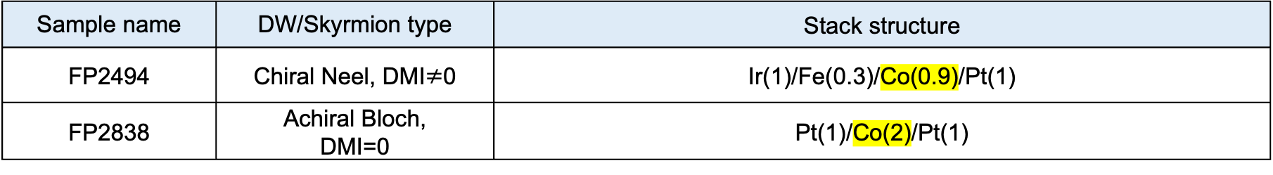
Comparison: Chiral + Achiral with similar MH curves
Sample name | DW/Skyrmion type | Stack structure
FP2494 | Chiral Neel, DMI$≠$0 | Ir(1)/Fe(0.3)/Co(0.9)/Pt(1)
FP2838 | Achiral Bloch, DMI=0 | Pt(1)/Co(2)/Pt(1)
Remanence similar for both
Both have sheared hysteresis loop, but chiral has a skinnier sheared loops, which implies lower anisotropy

Slide 11
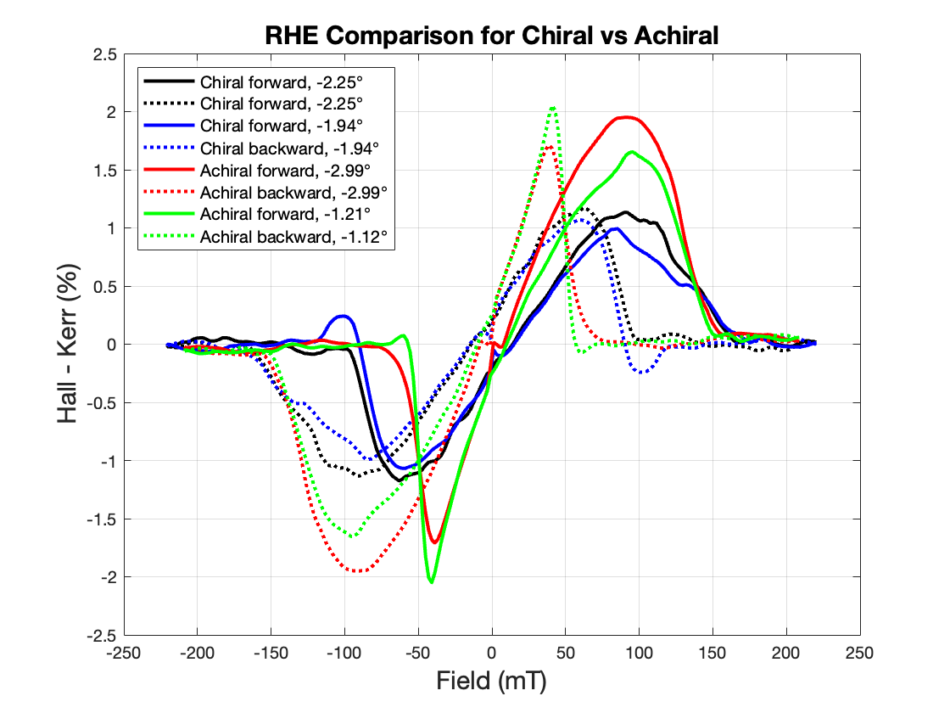
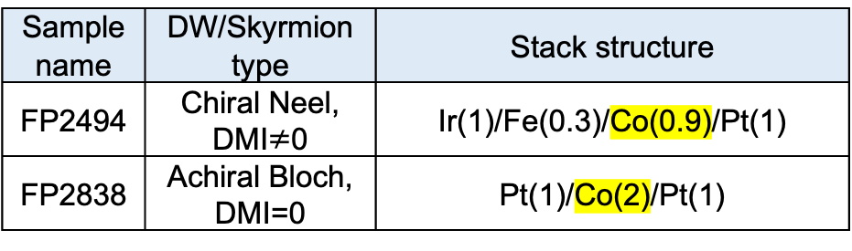
Comparison: Chiral vs Achiral with similar MH curves
Sample name | DW/Skyrmion type | Stack structure
FP2494 | Chiral Neel, DMI$≠$0 | Ir(1)/Fe(0.3)/Co(0.9)/Pt(1)
FP2838 | Achiral Bloch, DMI=0 | Pt(1)/Co(2)/Pt(1)
For RAHE paper, achiral RHE was larger than chiral RHE, for very different hysteresis loops
Here we achieve the same, but for similar hysteresis loops

Slide 12
Future Work
Make new samples: Pt/Co/Pt, Ir/Fe/CoPt, and Ir/Co/Pt to have similar hysteresis and measure their RHE for Co thickness and tilt dependence
Remeasure Chiral sample to reduce noise and see if there’s any tilt dependence

